Slide 1

Effects of NBA Schedule on game results
Mitchell Jones
CS-5483 Network Science
Project Final Report/Demonstration

Slide 2
Problem statement
What is the effect of the order on the NBA schedule on game results?
How does the number of rest days impact the number of games won and point differential over a defined period of games?
How does traveling from a specific city to another impact the number of games won and point differential over a defined period of games?
Period of games for both is 1, 2, 3, and 5 games

Slide 3
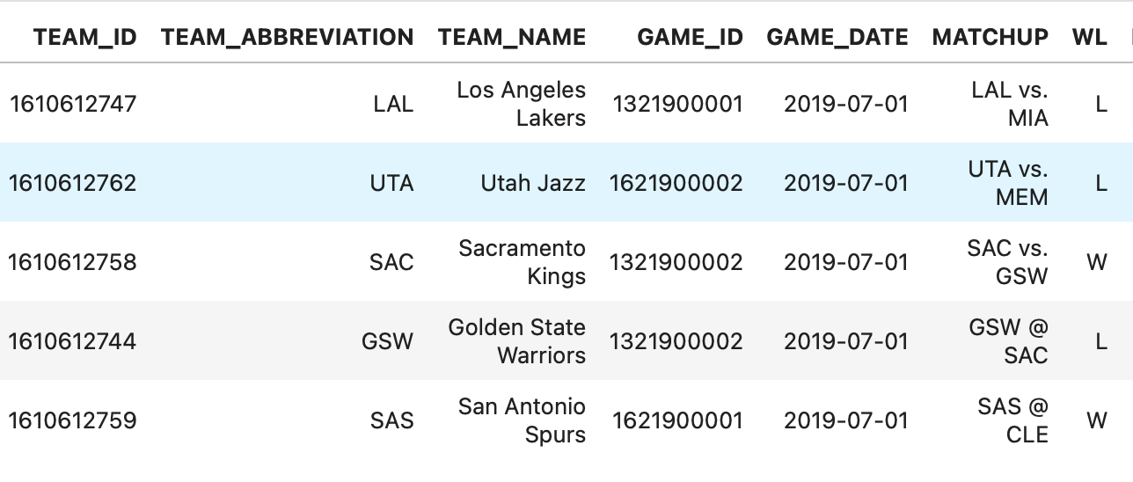
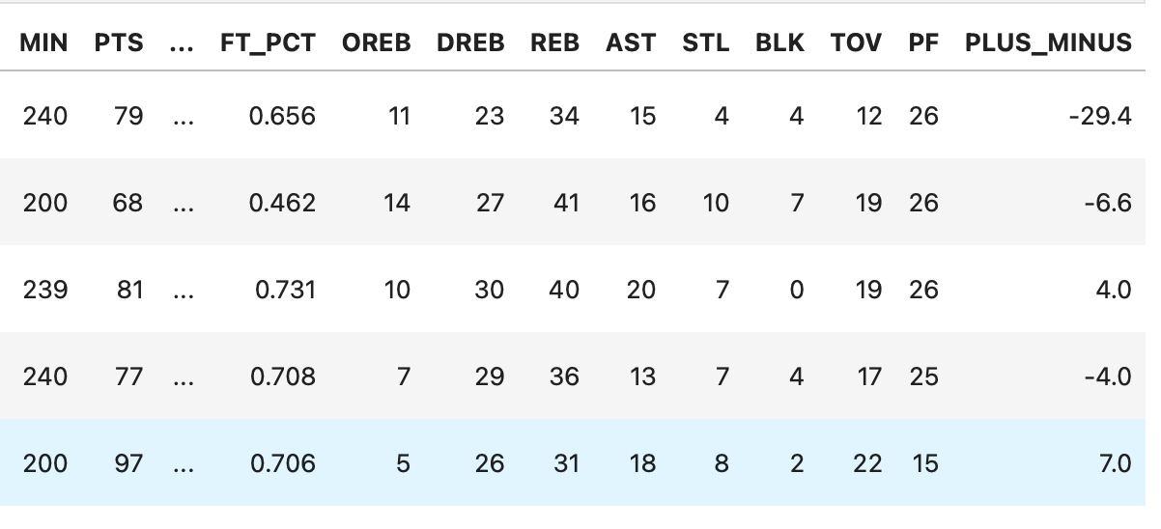
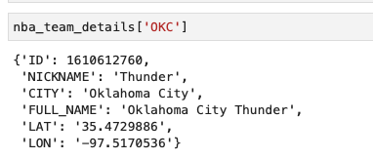
Datasets
NBA API – Easier Access to Official NBA Stats
Individual Game Stats
Pandas DataFrame with 2460 rows and 39 columns per season
Team Details
List of 30 dictionaries containing team ID, nickname, city, full name, latitude, and longitude
Both datasets are made from API endpoint data

Slide 4
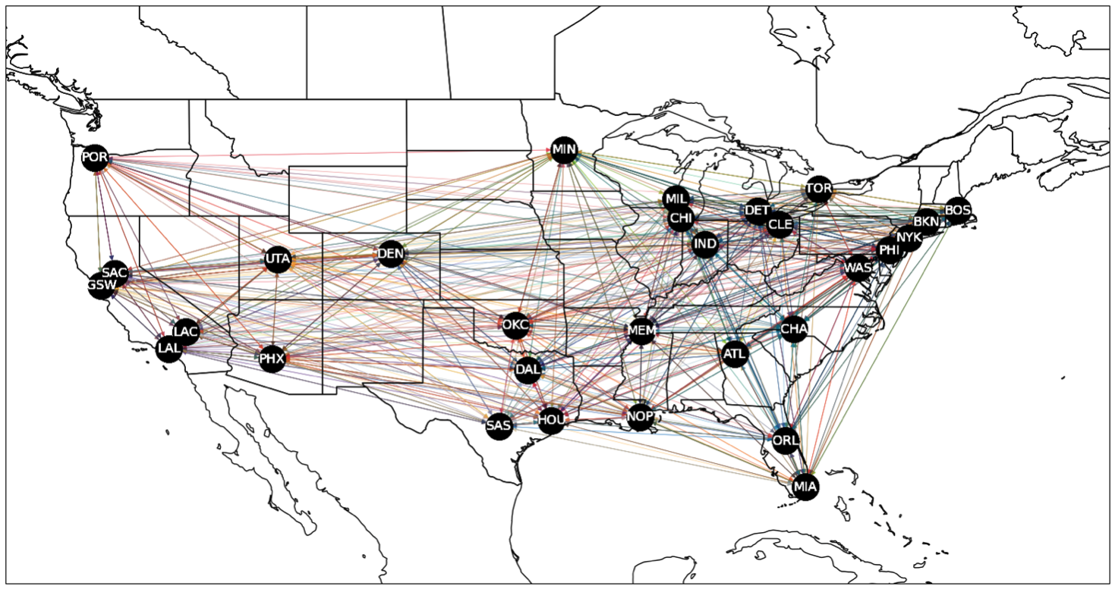
Network for all teams in 2016-17 NBA Season

Slide 5
Analysis
Analyzed win ratio, plus/minus, offensive, and defensive efficiency Examined all games from 2015-16 to 2018-19 NBA season (over 4000 distinct games)
Criteria for analysis:
Only examined data where the travel path is for consecutive games and where the travel path occurs more than 2 times
Analyzed periods with 1, 2, 3, 4, and 5 rest days between games and number of games played

Slide 6
Results and conclusion
For paths with 2 or 3 nodes, there was no discernable trend in any of the metrics
No paths with 4 or 5 nodes existed under the analysis criteria
Conclusion: Validation that NBA schedule makers produce randomized schedule where number of rest days travel paths do not have influence, how good a team is is what matters

Slide 7
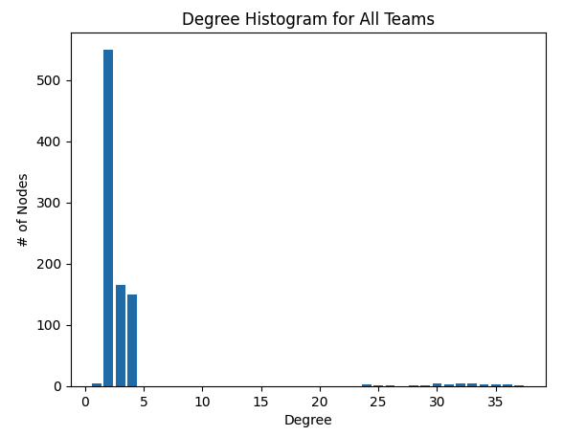
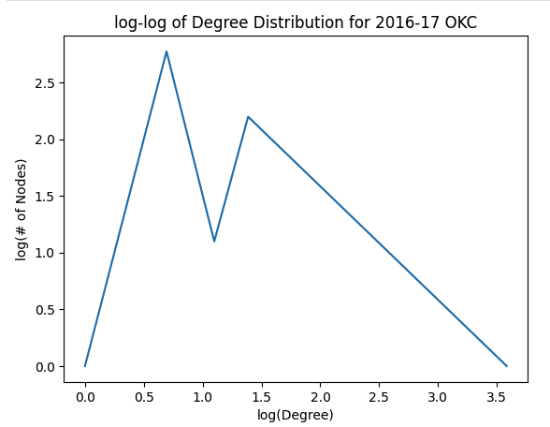
Degree distributions

Slide 8
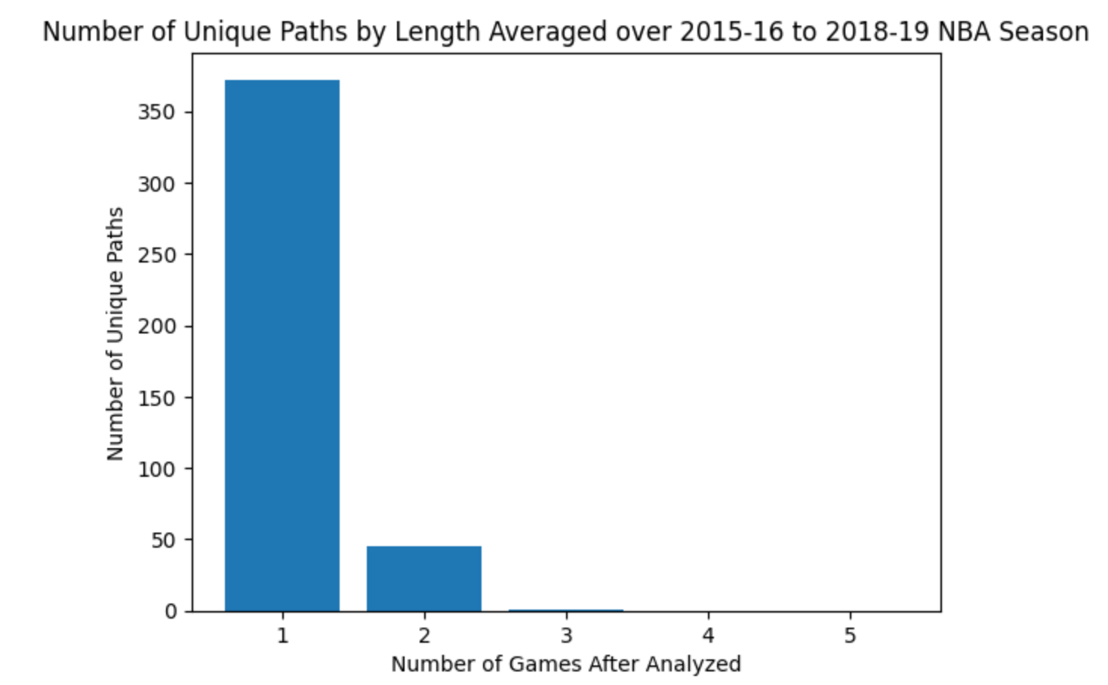
Analysis of Paths From Question 2

